Slide 1
WPMS Progress Presentation
By Group: BananaMen
Members: Aman Kumar Yadav, Ashwin Pokharel, Salon Rai,Unique Dhungana

Slide 2
Table Of Contents
Project Context
Problem Statement
Motivation
Aims
Objectives
Systems Investigated
Feature Comparison
Technology Comparison
Literature/Comparative Study Findings
Methodology
Requirement Elicitation
Elicitation Findings
System Requirements
Problem Domains
System Design
System Architecture Diagram
Activity Diagram
Use Case Diagram
Current Progress
Next Steps
Summary
Q & A

Slide 3
Project Context
Web-based Work Progress Management System (WPMS)
Bridges individual productivity and team/organizational coordination
Provide a unified workspace
Individual use to small collaborative teams

Slide 4
Problem Statement
Fragmented tools
Limited personal insight
Scalability gap
Performance verification gap

Slide 5
Motivation
Provide single environment
Work patterns, progress and productivity visibility
Support Personal work and collaborative projects
Scalable proof-of-concept/MVP

Slide 6
AIMS
Combine task, project and progress management
Provide individual and collaborative workspaces
Support work-hour and performance insight
Establish a foundation for future scalability

Slide 7
Objectives
Unify work management
Track individual progress
Enable collaboration:
Design for scalability:
Provide work evidence:

Slide 8
Systems Investigated
          Trello
          Asana

Slide 9
Feature Comparison
Asana
Trello
Tasks, subtasks, projects and multiple project views
Dashboards, search/filtering and collaboration
Comments, mentions, notifications and file attachments
Automation and connected project information
Boards → lists → cards as the central organisational model
Drag-and-drop task management
Comments, tagging, attachments and notifications
Power-Ups and extensions for additional functionality

Slide 10
Technology Comparison
Asana
Trello
React / TypeScript frontend
Multiple backend technologies and services
MySQL-backed persistence with caching/search infrastructure
Distributed infrastructure supporting large-scale operation
Web-based application
Node.js backend
React-based frontend
Cloud-based services & integrations

Slide 11
Literature/Comparative Study Findings
A single source of truth can support multiple task/project views
Dashboards can derive useful insights from structured task and time data
Collaboration can be supported through comments, mentions, notifications and activity logs
Advanced features should be adapted to the MVP's scale and technical constraints

Slide 12
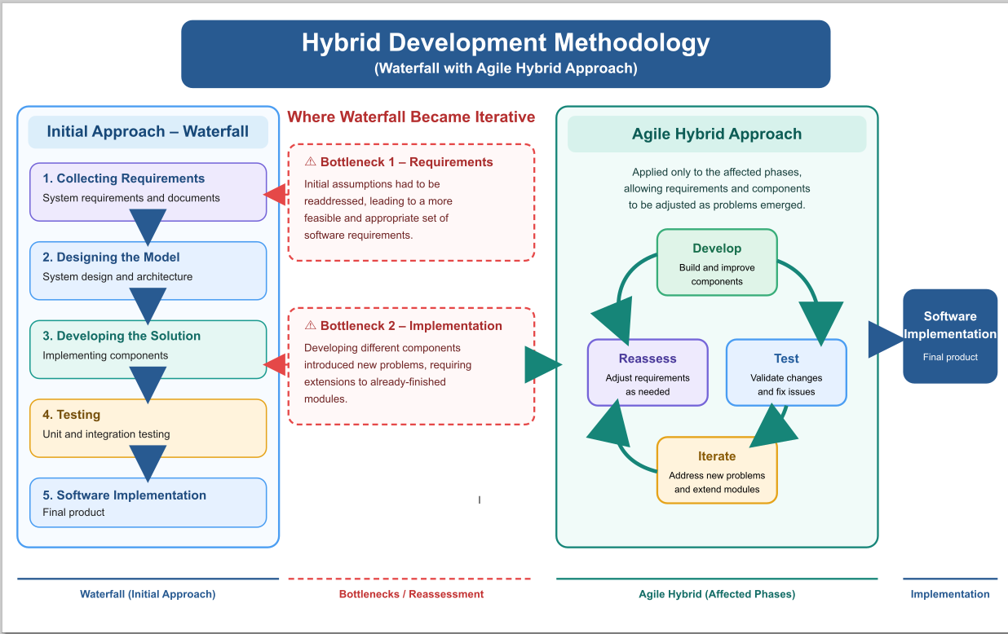
Methodology

Slide 13
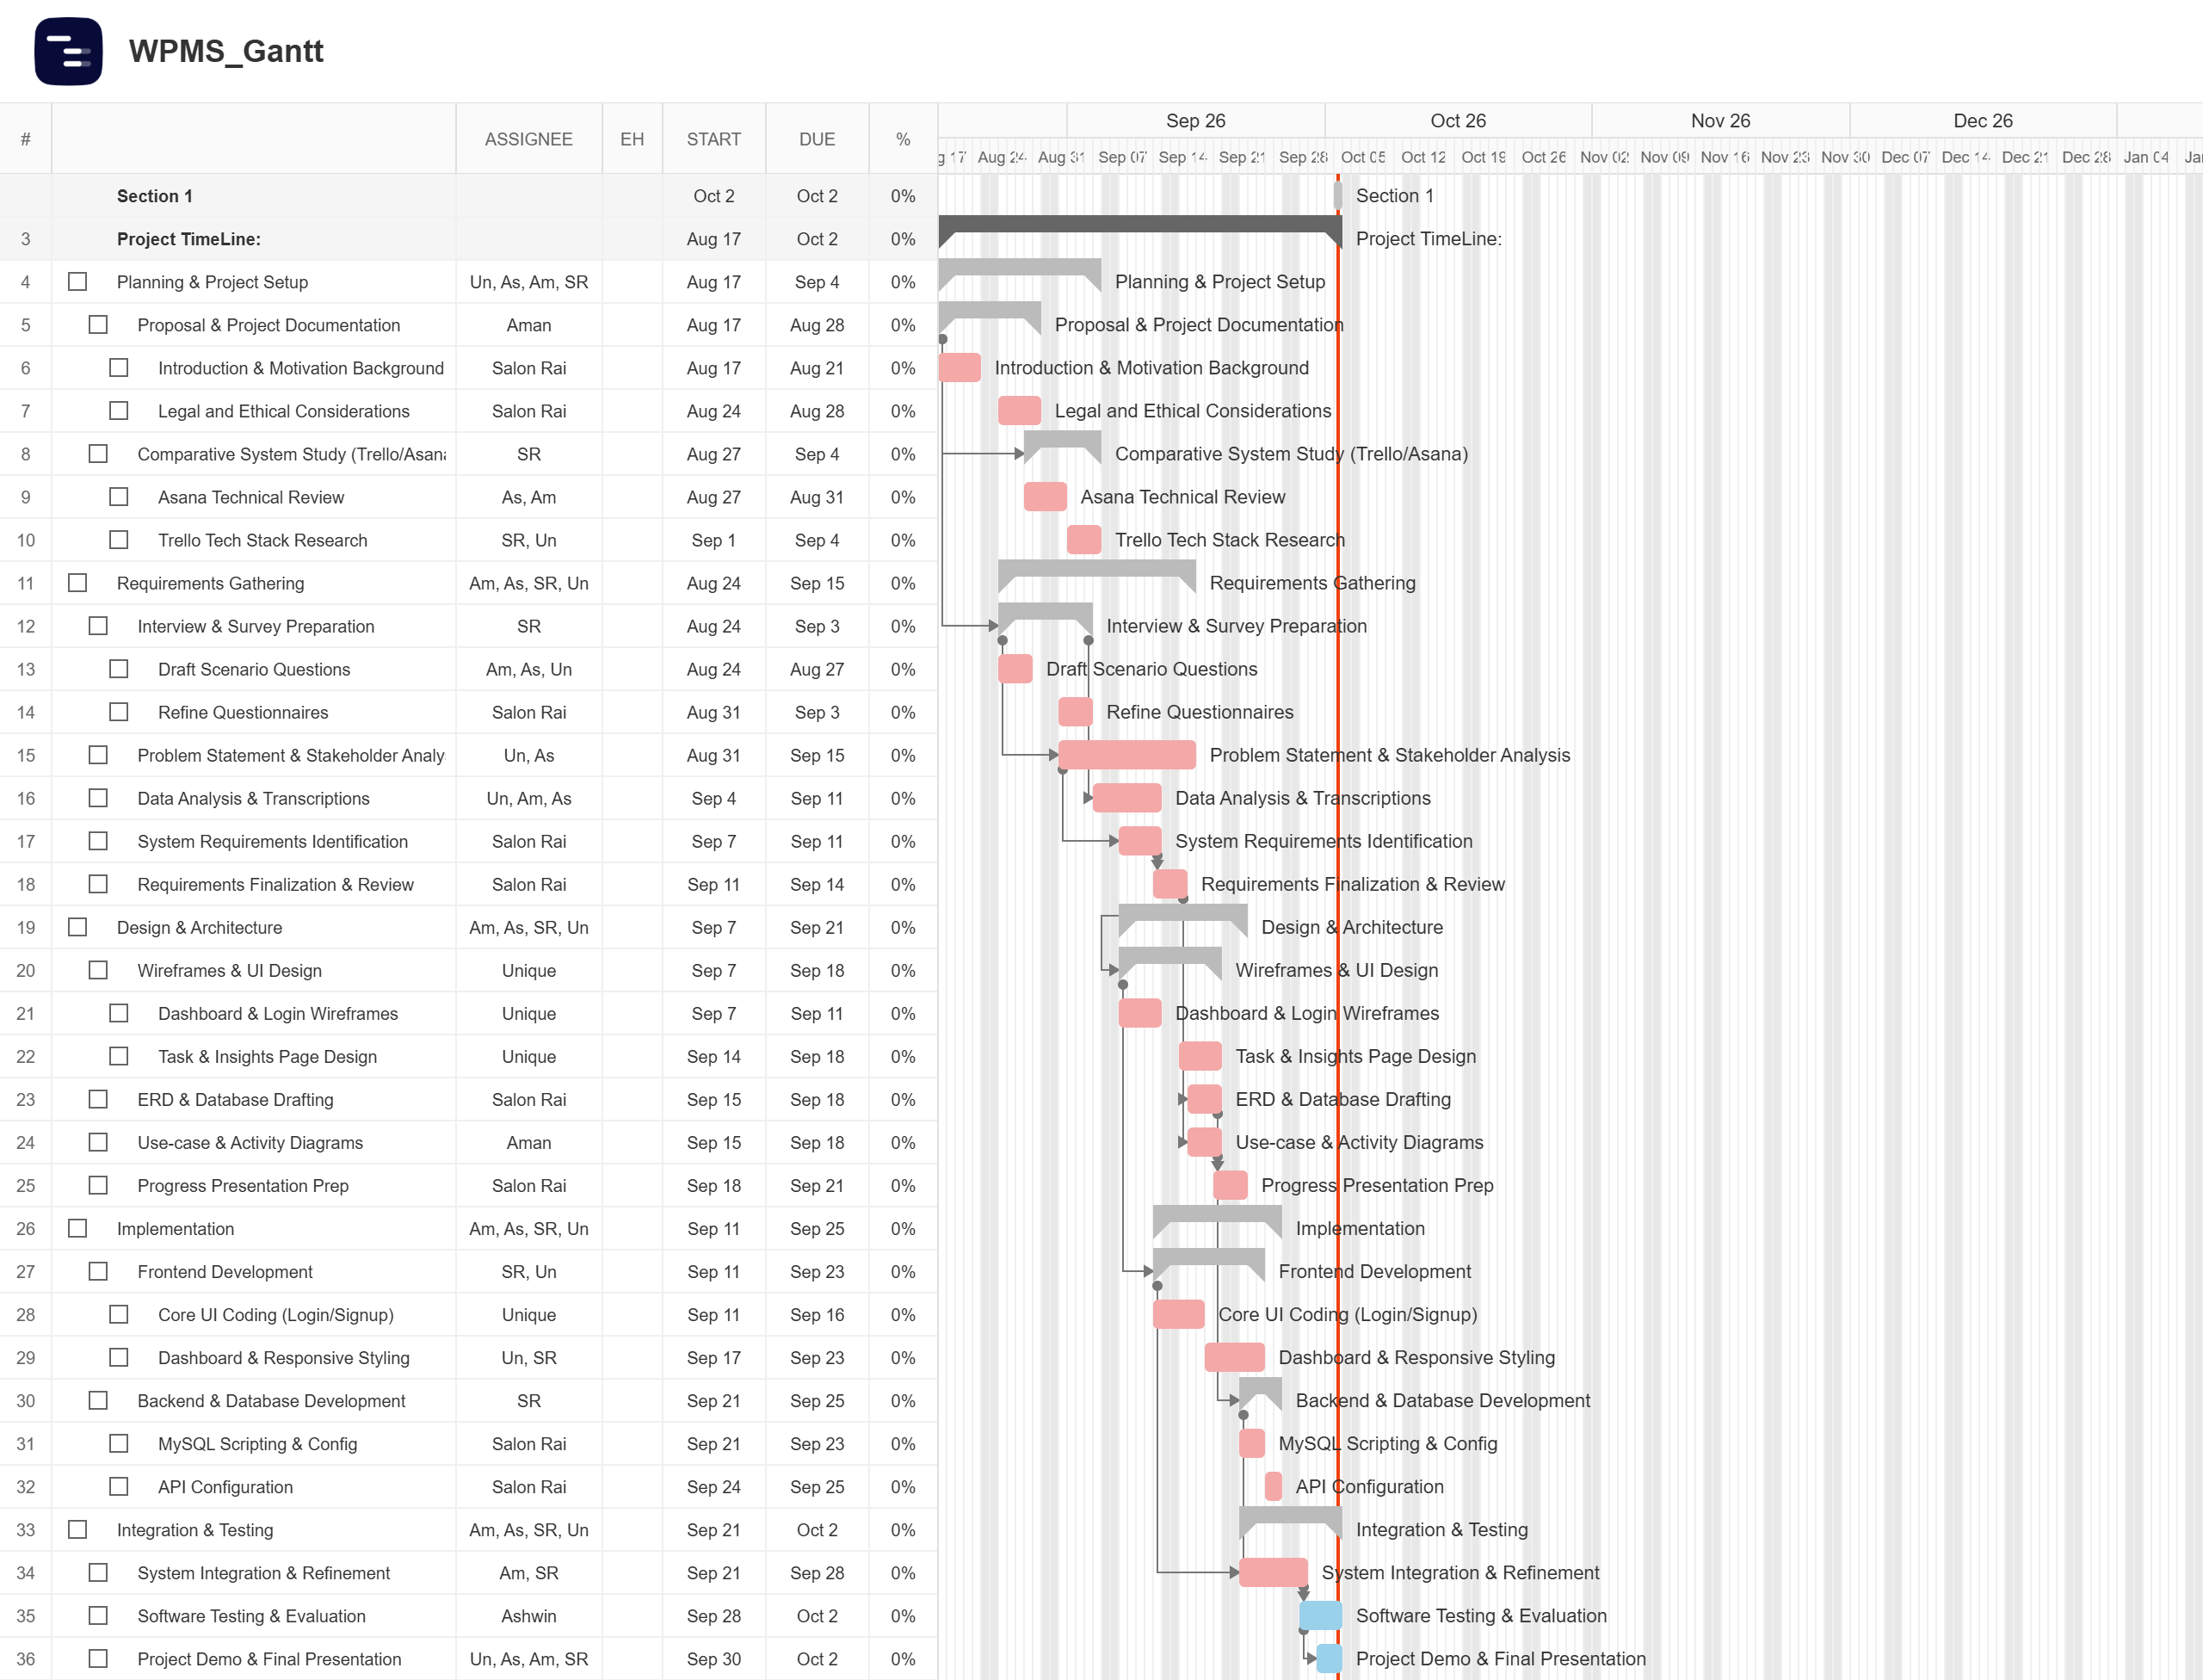
Gantt Chart

Slide 14
Requirements Elicitation
Survey focused on people involved in collaborative and individual work
Areas included students, freelancers, contractors and creative/collaborative work
An interview was conducted with a small startup company
Findings were compared with the comparative technology study

Slide 15
Elicitation Findings
Users need a personal workspace alongside collaborative project spaces
Task management needs to include dependencies, deadlines and progress
Work hours and progress should be connected to the work being completed
Collaboration requires comments, shared workspaces, notifications and controlled access

Slide 16
System Rquirements
Personal & Task Management
Progress & Work Hours
Collaboration
Access & Evidence

Slide 17
Problem Domains
User Identity & Access Management
Task Lifecycle & Context Aggregation
Dependency & Dynamic Timeline Engine
Workload Capacity & SLA Effort Tracking
Analytics & Performance Metrics Engine

Slide 18
System Design
                Table of Diagrams:
System Architecture Diagram
Entity Relation Diagram
Activity Diagram
Use Case Diagram

Slide 19
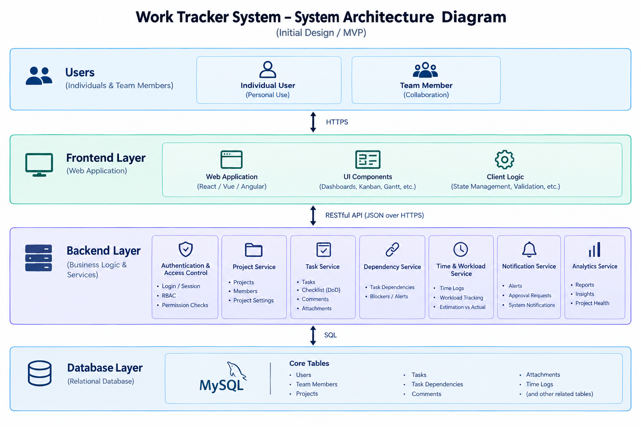
System Architecture Diagram

Slide 20
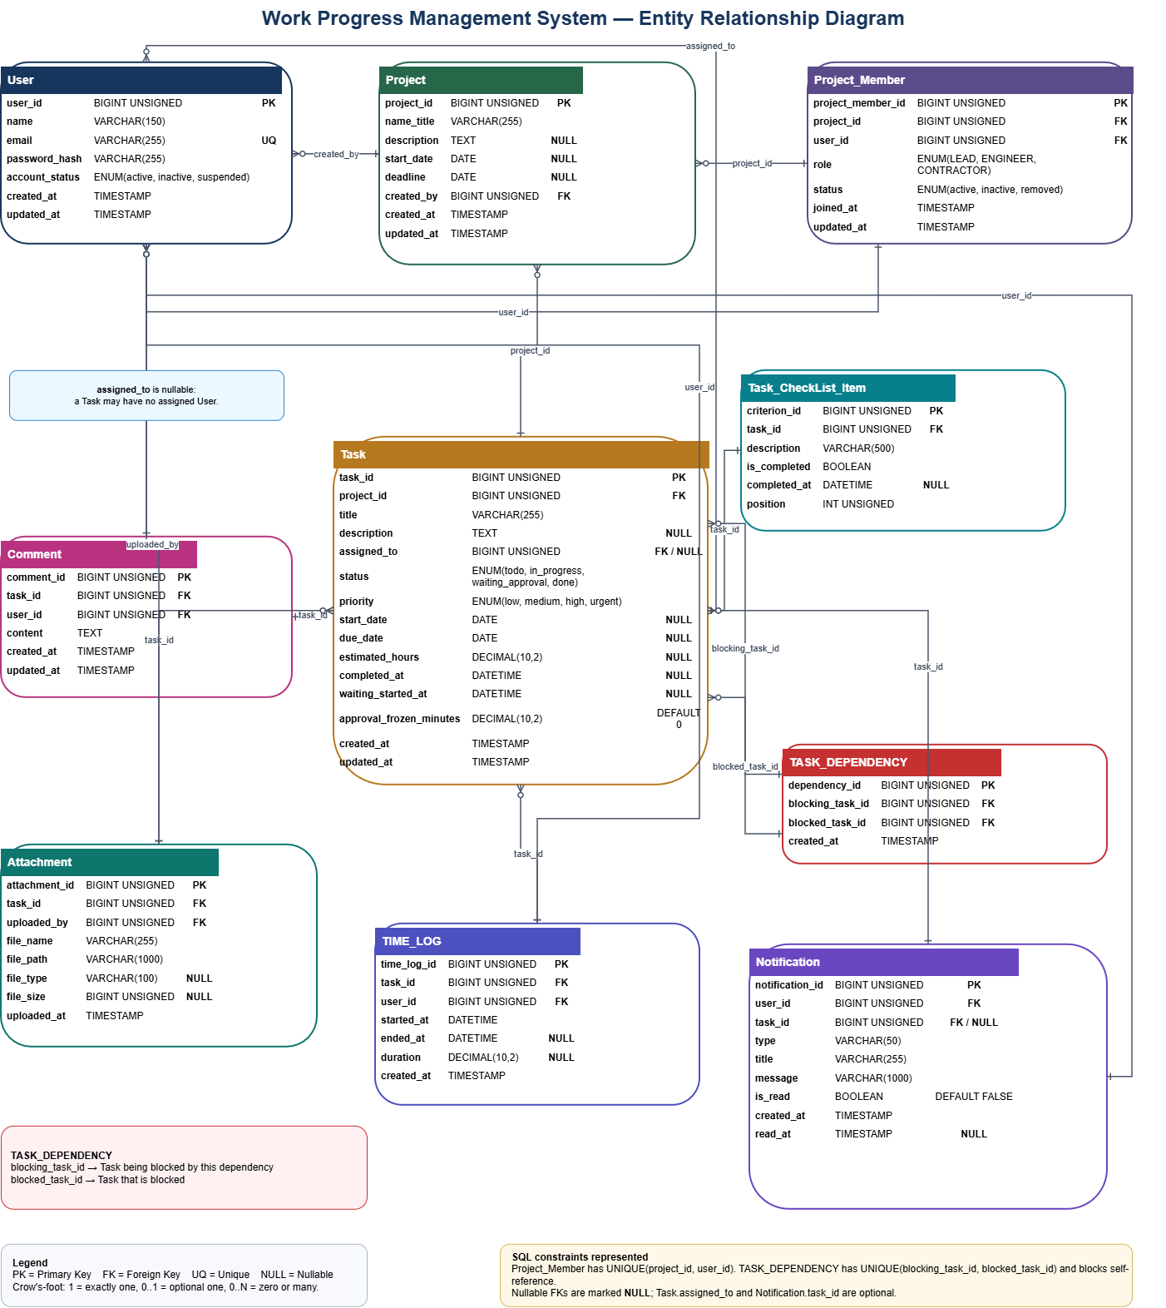
Entity Relation Diagram

Slide 21
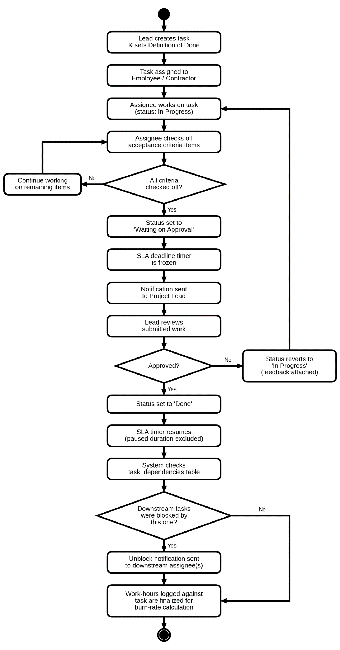
Activity Diagram

Slide 22
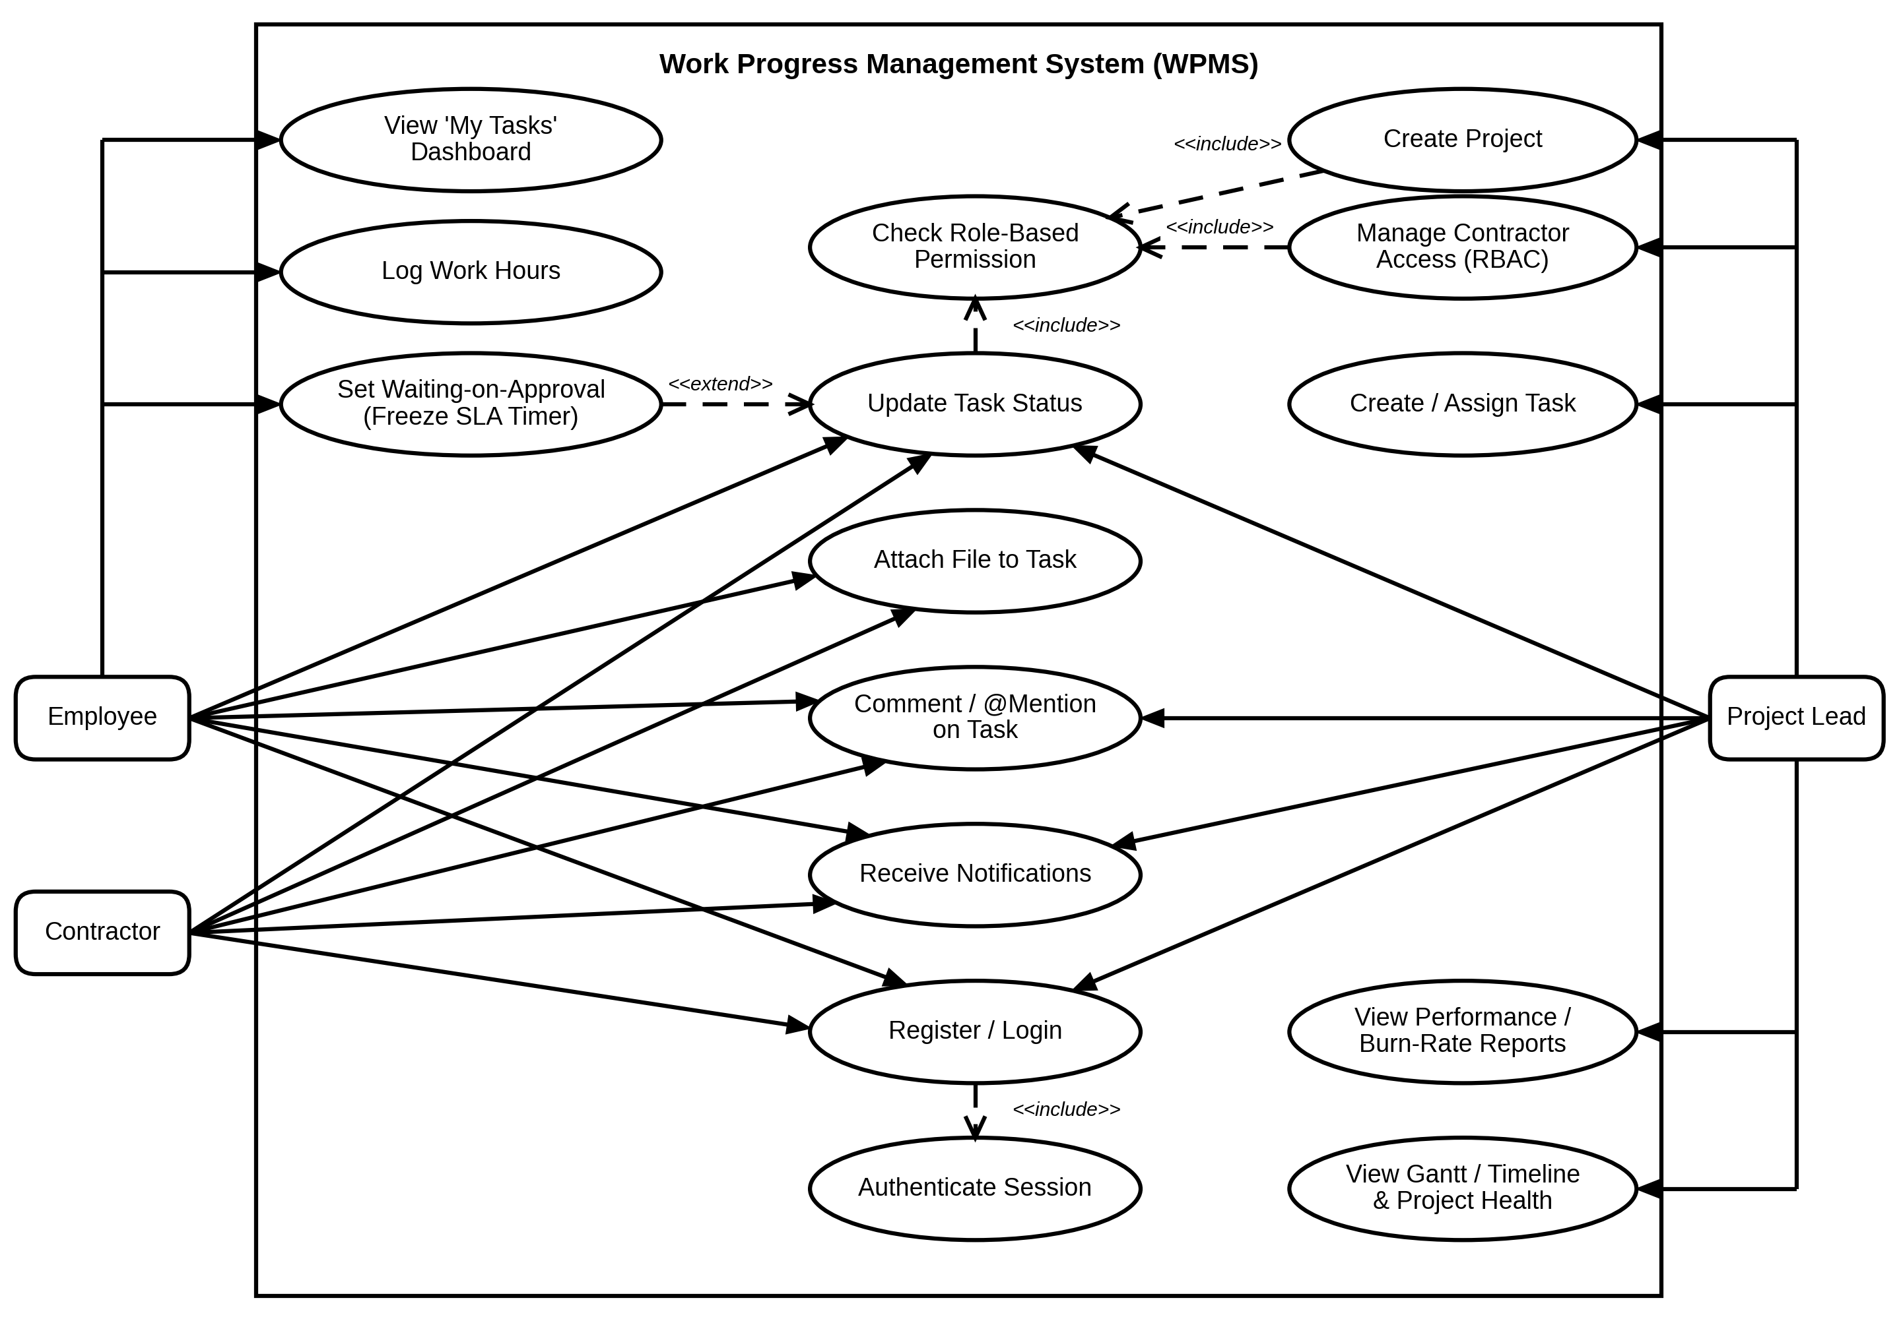
Use Case Diagram

Slide 23
Implementation: Tech Stack
Layer | Technology
Frontend | HTML5 + CSS3 + JavaScript (ES Modules)
Backend | Node.js + Express-style HTTP routing
Database | MySQL 8.x
Communication / Networking | HTTP/REST API + JSON + session cookies

Slide 24
Implementation: Mock Ups
Login Page
Home Page
Task Page
Analytics Page
Project Contributor Page

Slide 25
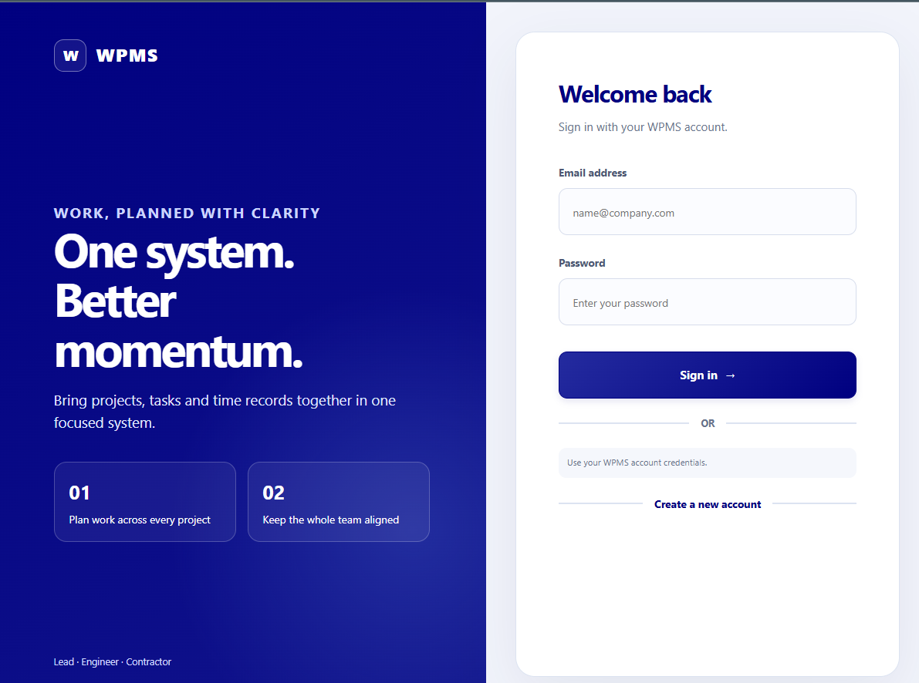
Login Page

Slide 26
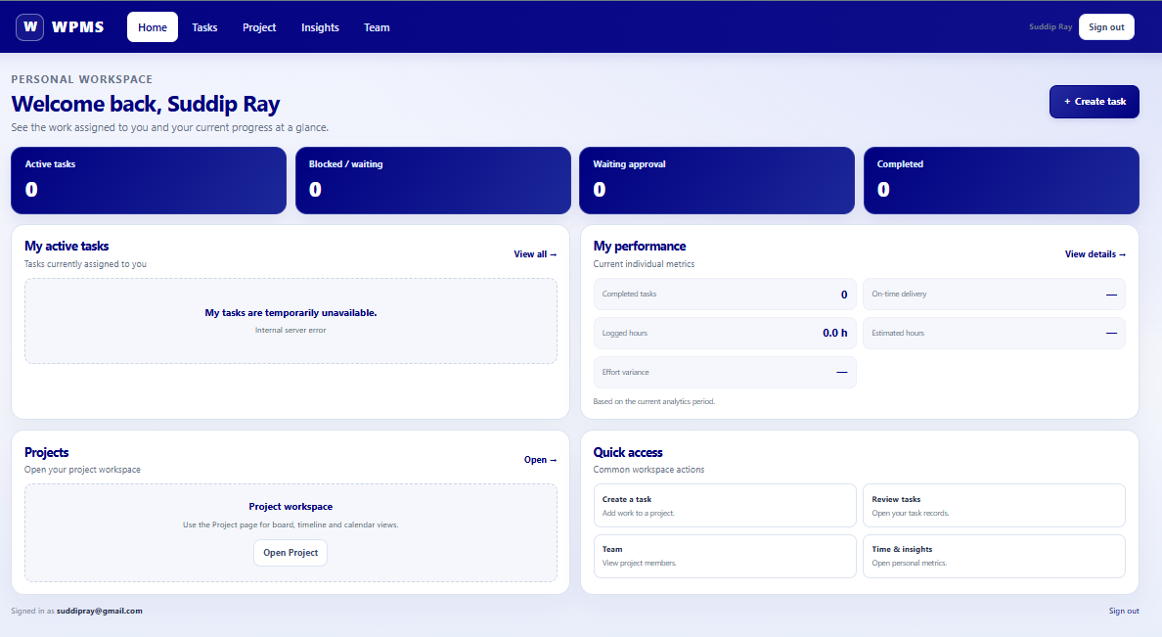
Home Page

Slide 27
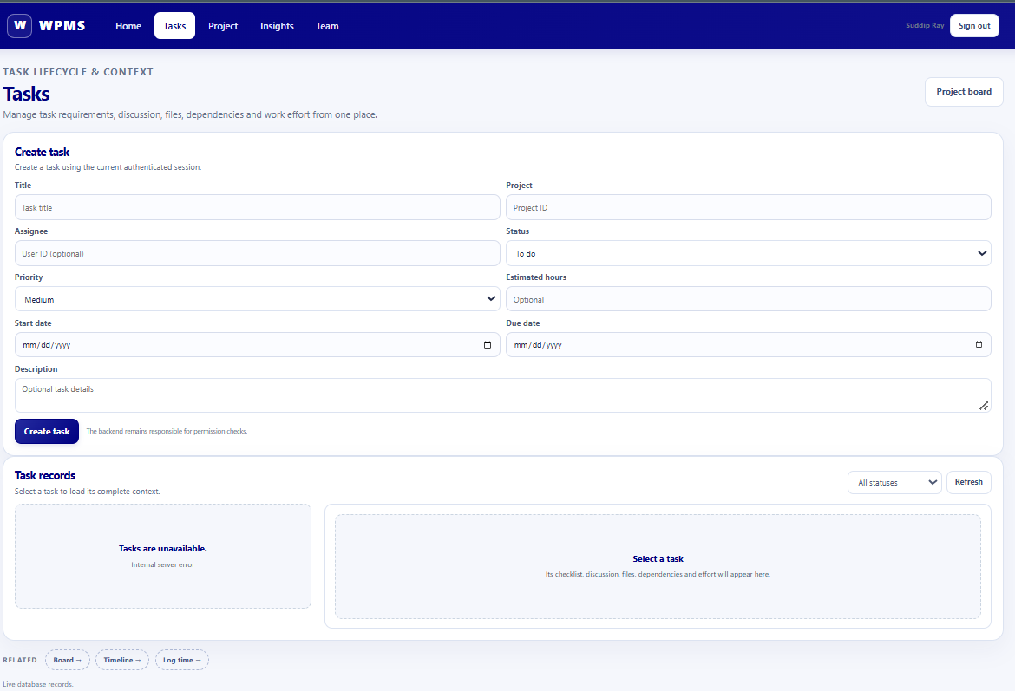
Tasks Page

Slide 28
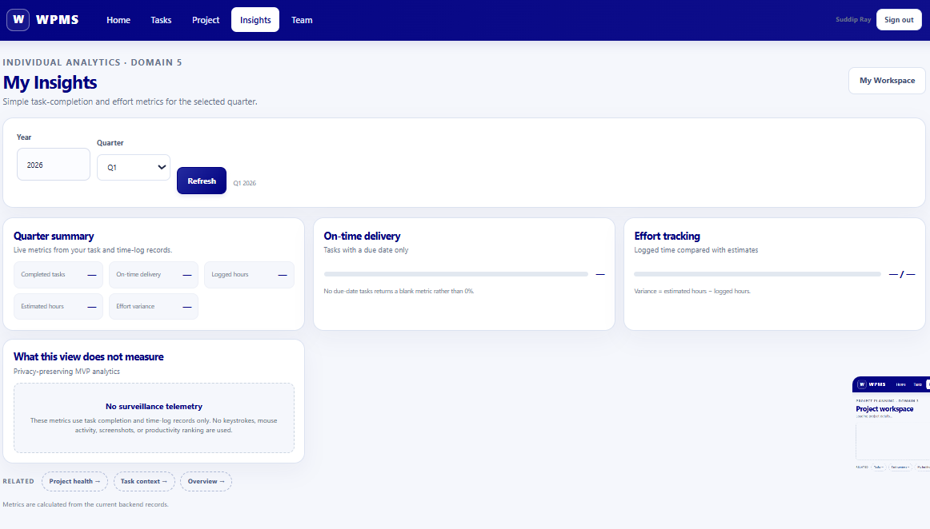
Analytics Page

Slide 29
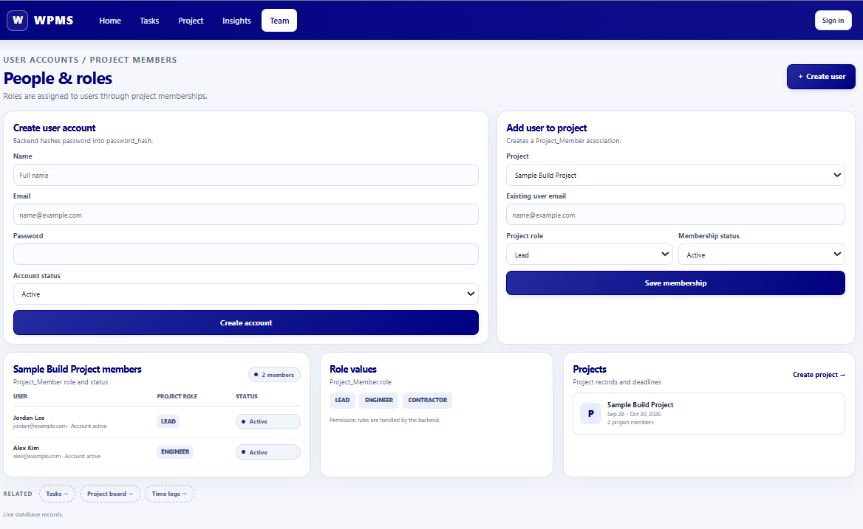
Project Contributors
Page

Slide 30
Summary
Project Overview
Methodology
System Design
System Implementation

Slide 31
Q & A

